Slide 1
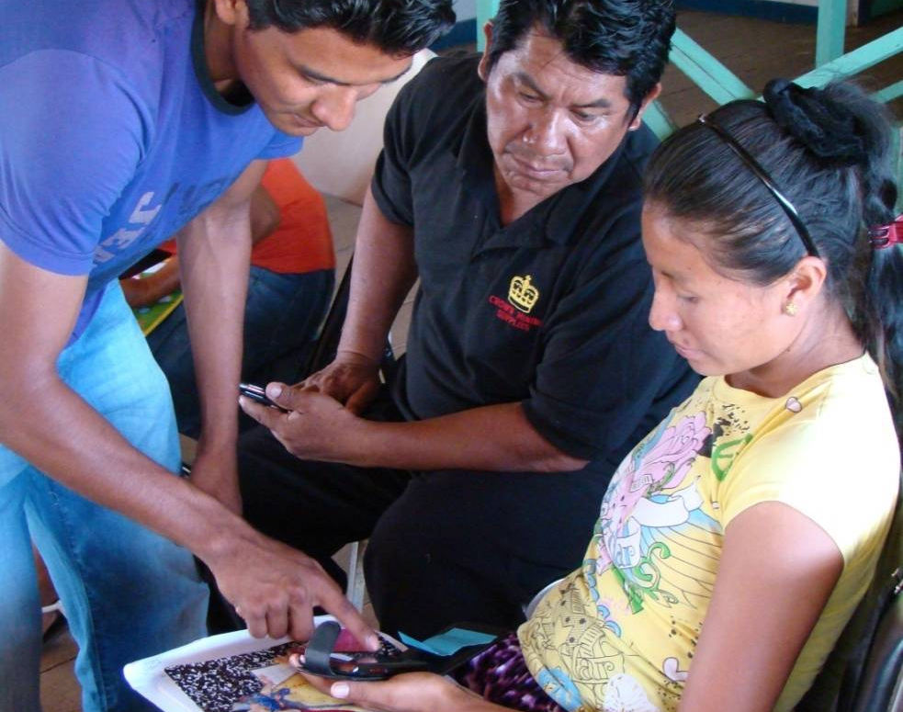
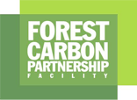
Module 2.4 Incorporating community-based monitoring in national (or jurisdictional) REDD+ monitoring
Module developers:
Margaret Skutsch, Universidad Nacional Autónoma de Mexico
Arturo Balderas Torres, Universidad Nacional Autónoma de Mexico
Country example:
Guyana
For this country example we would like to thank Helen Bellfield of the Global Canopy Programme for her kind assistance and inputs.
V1, May 2015
Creative Commons License

Slide 2
Background information
Via this link you can access a blog that tracks the evolution of Global Canopy´s program to develop a toolkit for carbon monitoring by local communities in the North Rupununi area. Among other features, the toolkit makes use of handheld technologies.
http://communitymrv.org/guyana-project/

Slide 3
Community measuring, reporting, and verification (CMRV) in Guyana
Guyana is a country with a very low rate of deforestation.
Nevertheless, Guyana’s government is very interested in participating in REDD+ and in involving communities in this.
A community MRV pilot project financed by NORAD has been implemented by the Amerindian communities of the North Rupununi in collaboration with the Global Canopy Programme in North Rupununi, the North Rupununi District Development Board, and the Iwokrama International Centre
Notes:
NORAD = Norwegian Agency for Development Cooperation

Slide 4
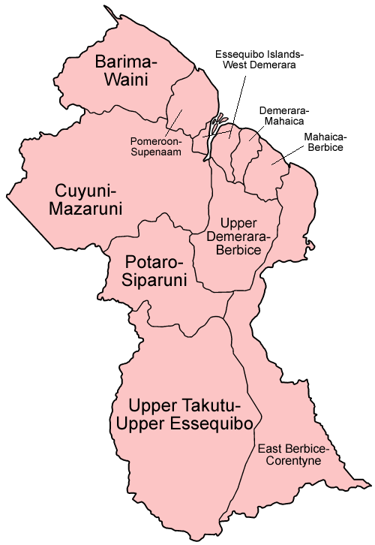
Project location
The project is in
North Rupununi district
in Upper Takutu-Upper
Essequibo region
Map courtesy of Wikipedia

Slide 5
CMRV pilot project
The CMRV pilot project has been working closely with the Guyana Forestry Commission, acting as a Community Demonstration Site.
The goals are to test the efficacy and value of community-based monitoring to the emerging national MRV system and to support Amerindian participation in the proposed national REDD+ “opt-in” mechanism.
Community groups are using handheld electronic devices to capture data on biomass in their forests and other variables.

Slide 6
Data collection
A local project management team and 32 community monitors have been trained to collect and analyze data on forest change and drivers of change, above ground biomass, other natural resources, and community well-being.
The data collected by the communities helps them to:
Make an informed decision on whether to opt-in to REDD+ schemes
Sustainably manage their resources
Enhance national monitoring efforts with detailed local information

Slide 7
Data collection and analysis
The community monitors use Android smartphones to collect the data.
Open Data Kit’s (ODK’s) Collect app is used for data collection and submission; the ODK app enables different monitoring forms to be built by the local project management team.
Data is managed in a cloud-based system using a local web server.
Data is analysed by the local project management team, supported by GCP and IIC, using a range of tools including MS Excel, S-map, Arc GIS and Google Earth Builder.
Notes:
Google´s Open Data Kit (ODK) is an alternative to the Cybertracker system we have used in this course. We believe that Cybertracker is more user friendly, but ODK is also widely used in community monitoring.
GCP = Global Canopy Project
IIC = Iwokrama International Centre

Slide 8
Choice of the handheld device was determined by several factors
Screen size and brightness
Battery life
Durability and robustness
Operational and user interface (ease of entering data)
Operational and user interface (ease of use generally)
GPS capacity
Size
Note: It became clear only after field trials how important the first three of these criteria are!

Slide 9
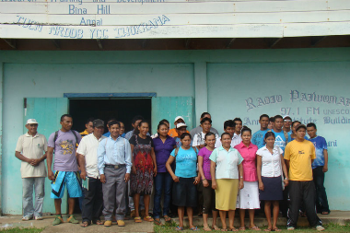
The monitoring team

Slide 10
Agree method for data collection, processing, reporting.
Set appropriate timescales
Plan training for monitoring team.
Build and test data collection form.
Form Creation Procedure
Deliver training to monitoring team.
Data collection / regular progress reports
Data Collection Procedure
Data auditing’ and processing
Data analysis by PMT and monitoring team
Data Processing Procedure
Data reporting
Data sharing protocol
Notes:
This slide demonstrates the steps that are followed in the monitoring cycle. Note that there is collaboration with the community in designing the procedure.
Note: PMT = project management team.

Slide 11
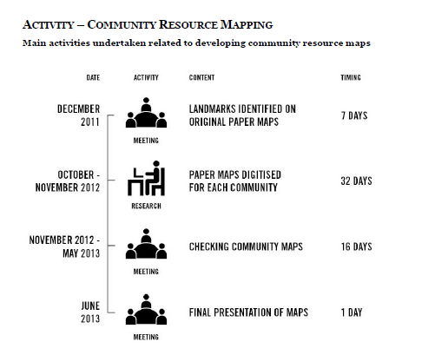
Sample activity workplan
Activity – Community Resource Mapping
Main activities undertaken related to developing community resource maps
Date Activity Context Timing

Slide 12
Evaluation (1/4)
Were the most useful and relevant indicators selected to monitor?
Figure: Reaction of the monitoring team, toshaos, and Project Management Team to the final monitoring framework
Notes:
This slide shows how different groups participating in the monitoring exercise perceived the usefulness of the indicators that were used. More than 40% thought that the indicators used were not the best ones. This demonstrates the importance of good discussions with all parties involved before the monitoring protocol is drawn up.
Toshaos → representing indigenous groups: Amerindian people of Guyana

Slide 13
Evaluation (2/4)
Do you feel the priorities of your communities were taken into account when deciding what to monitor in the CMRV project?
Figure: Response of toshaos and village councillors to the selection of the monitoring framework
Notes:
However, from this slide it is clear that the community did feel engaged in the process and did feel that its interests had been taken seriously.

Slide 14
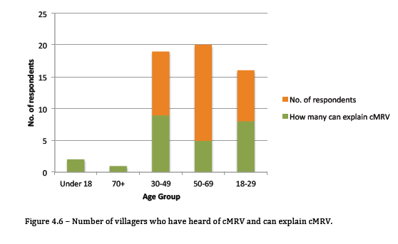
Evaluation (3/4)
No. of respondents
Figure: Number of villagers who have heard of cMRV and can explain cMRV
Notes:
This slide provides an indication of how many people were engaged in the process.

Slide 15
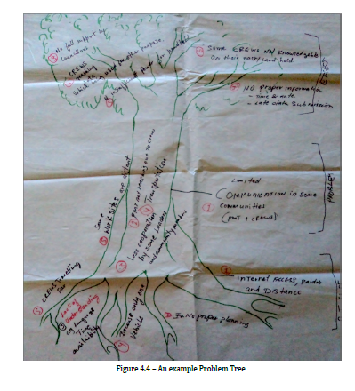
Evaluation (4/4)
Figure: An example Problem Tree
Notes:
A participatory “map” of the process undergone, as developed in the evaluation exercise.

